Slide 1
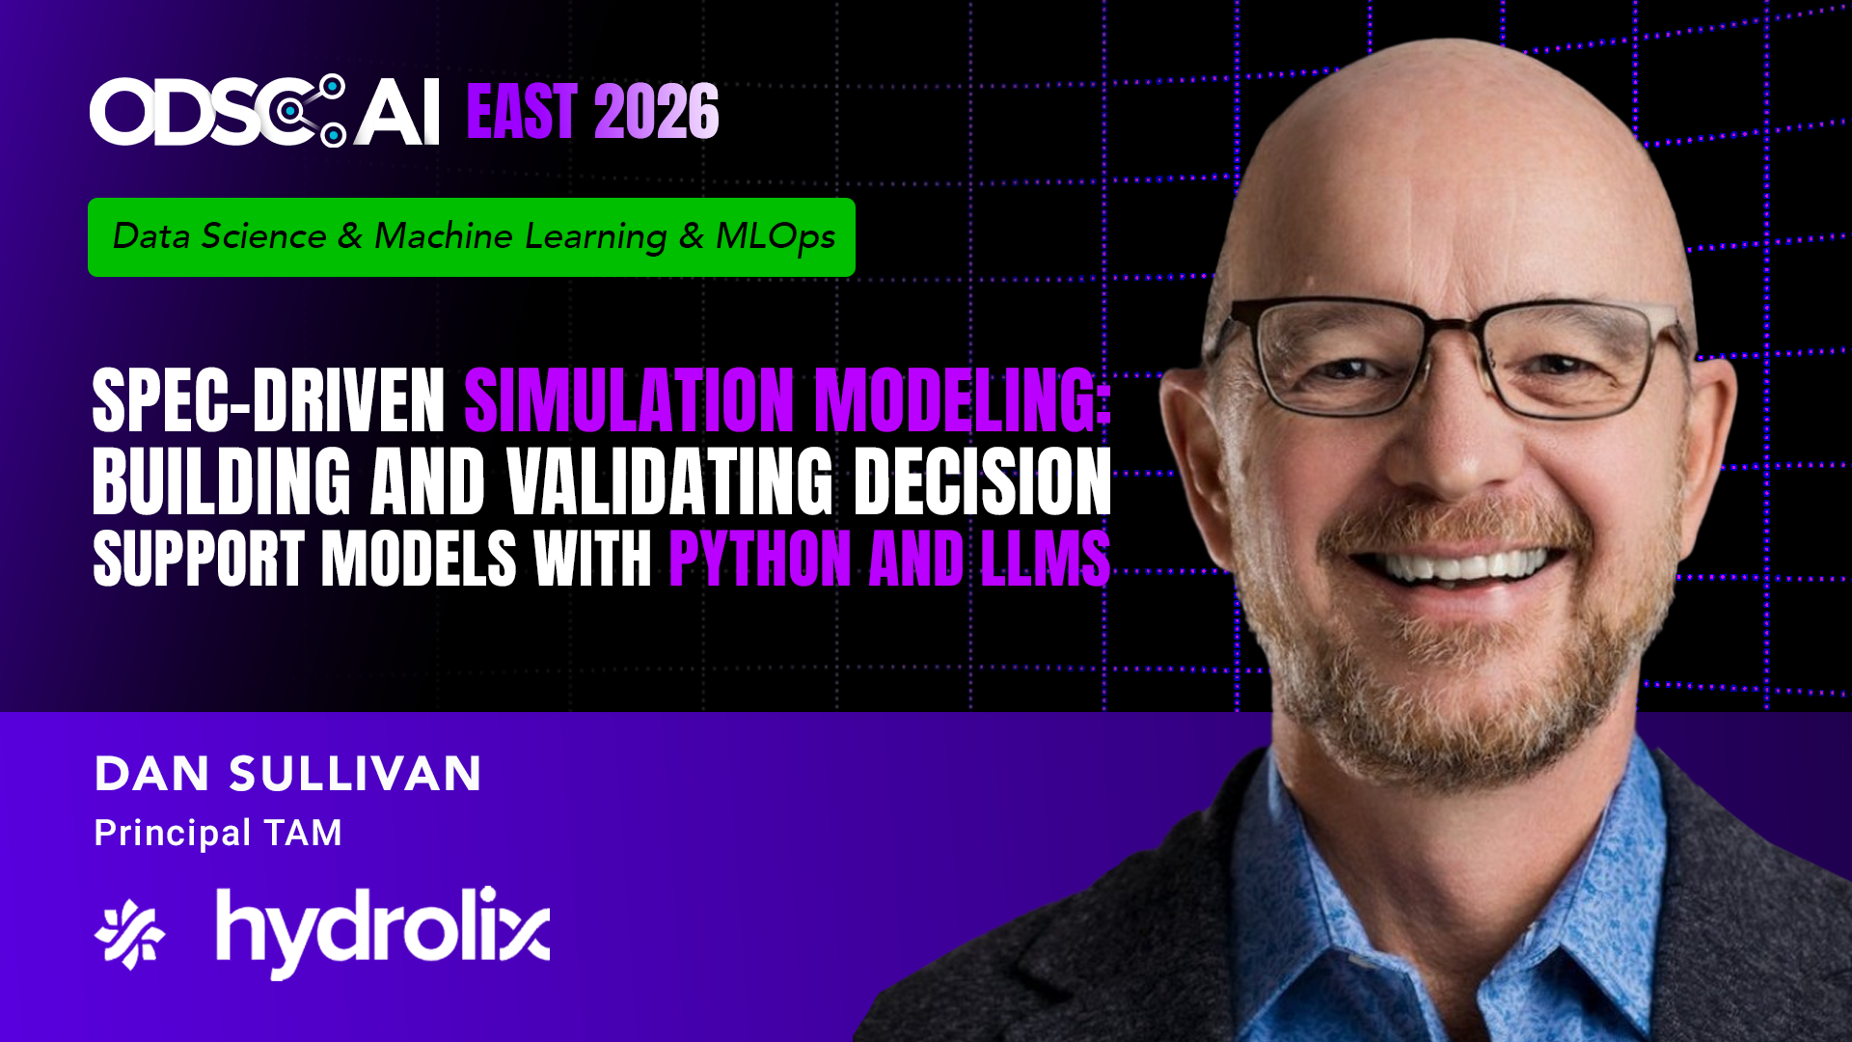

Slide 2
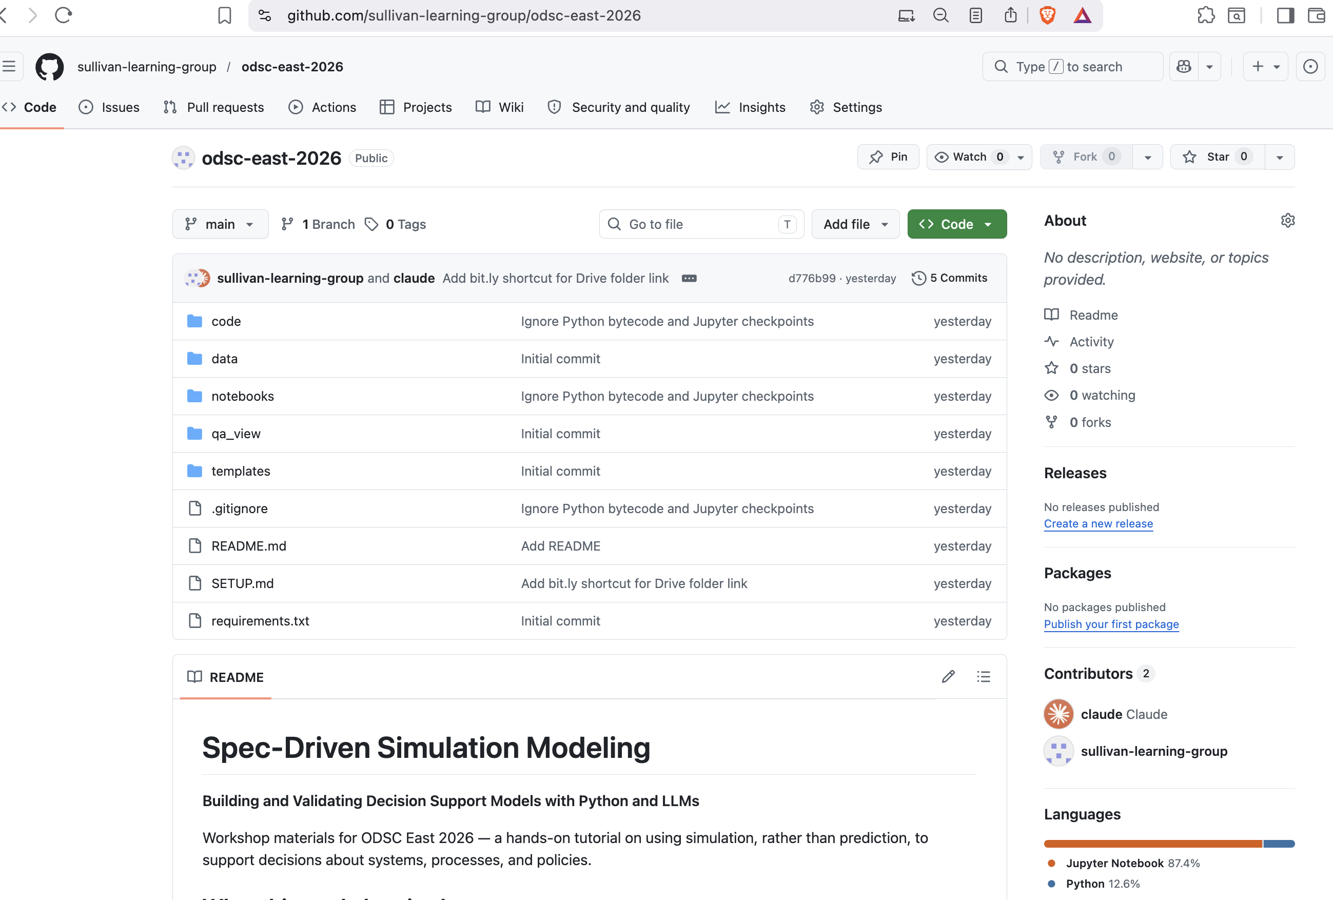
Tutorial Github Repo
Clone or browse the repo:
https://github.com/sullivan-learning-group/odsc-east-2026
Slides, notebooks, templates, and the completed Template A/B/C examples.

Slide 3
Spec-Driven Simulation Modeling
Building and Validating Decision Support Models with Python and LLMs
Dan Sullivan · ODSC East 2026
Author, Simulation Models for Data Science (forthcoming, O'Reilly)
Notes:
Welcome. Two hours, hands-on. We'll build and validate a discrete event simulation that answers a real business question, using a spec-driven workflow with LLMs in the loop at every stage.

Slide 4
Today’s Session
1
When predictive models aren't enough
2
Distributions and SciPy fitting
3
Template A — the process spec
4
Template B — spec to SimPy with LLMs
5
Template C — LLM-assisted validation
6
Scenario comparison and the decision
7
Wrap and where to go next
Notes:
Agenda slide. Lecture interleaved with hands-on. About half the time is hands-on at the keyboard.

Slide 5
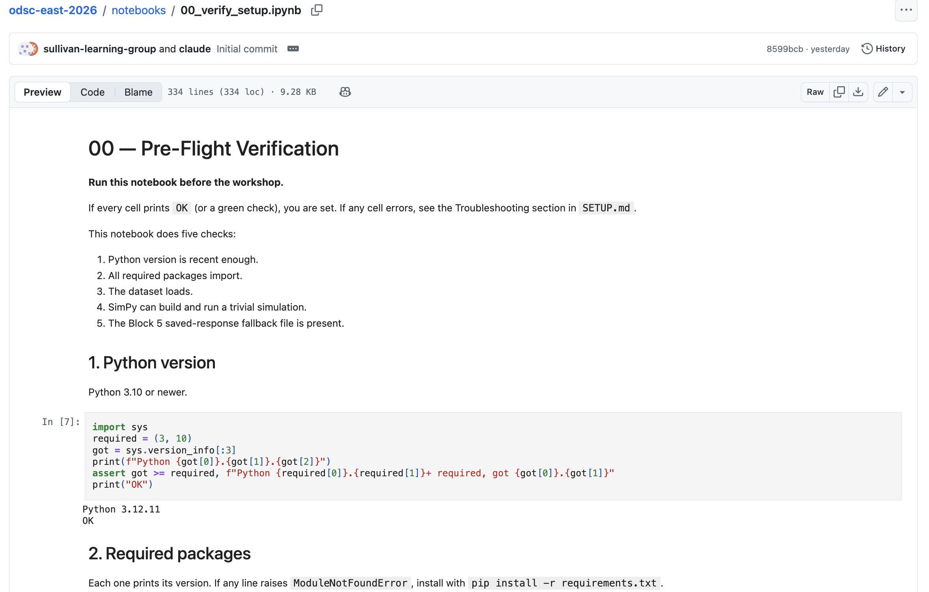
Setup Check

Slide 6
Four families of simulation
Monte Carlo
Discrete event simulation
Sample inputs, push through formula, summarize. No time, no queues. Risk profiles, project costs.
Track entities through processes that consume resources over time. Bottlenecks, waits, queues.
System dynamics
Agent-based modeling
Continuous stocks and flows with feedback. Policy ripples, market share over years.
Individual agents with simple rules. Emergent behavior, lane formation, opinion spread.
Today's question is about queues, waits, and time-sensitive resource constraints. → DES.
Notes:
Four families. Knowing which one to reach for is the first decision in any simulation project. Monte Carlo for risk; DES for queues and bottlenecks; system dynamics for feedback over time; ABM for emergent behavior. The deciding factor for DES is whether *when* things happen matters as much as *what* happens.

Slide 7
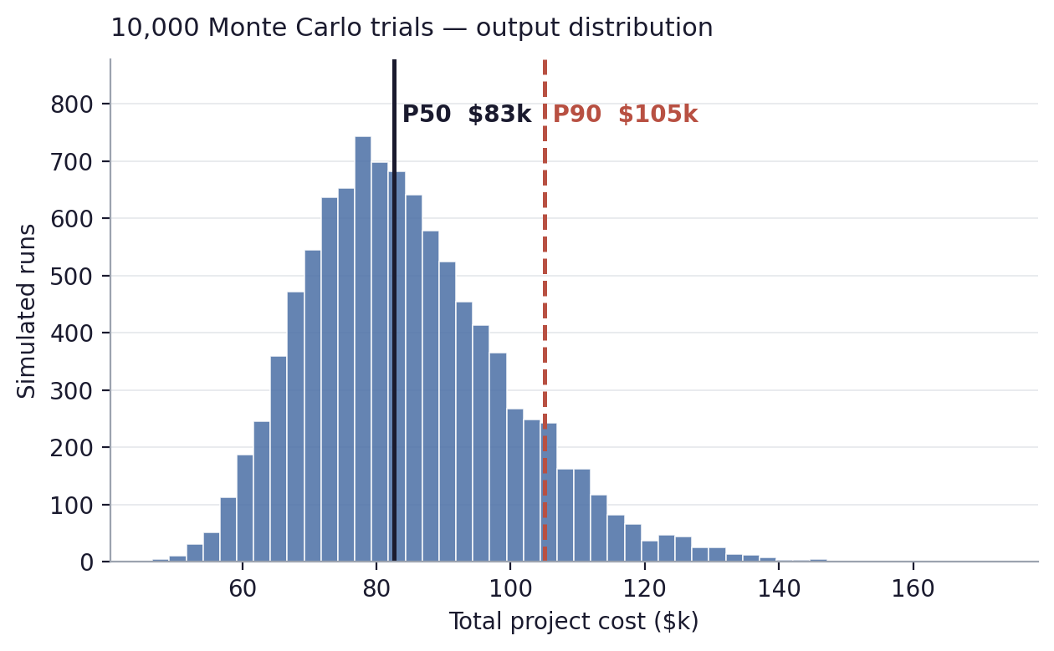
Monte Carlo simulation
Risk and uncertainty in one number
Sample inputs from probability distributions
Push every sample through a deterministic formula
Repeat thousands of times to build an output distribution
Time does not appear — no clock, no queues
Answers: how likely is each outcome?
Cost = labor + materials + (rare risk events). 18% of trials exceed the P90.
Use cases: project costs, portfolio risk, NPV ranges.

Slide 8
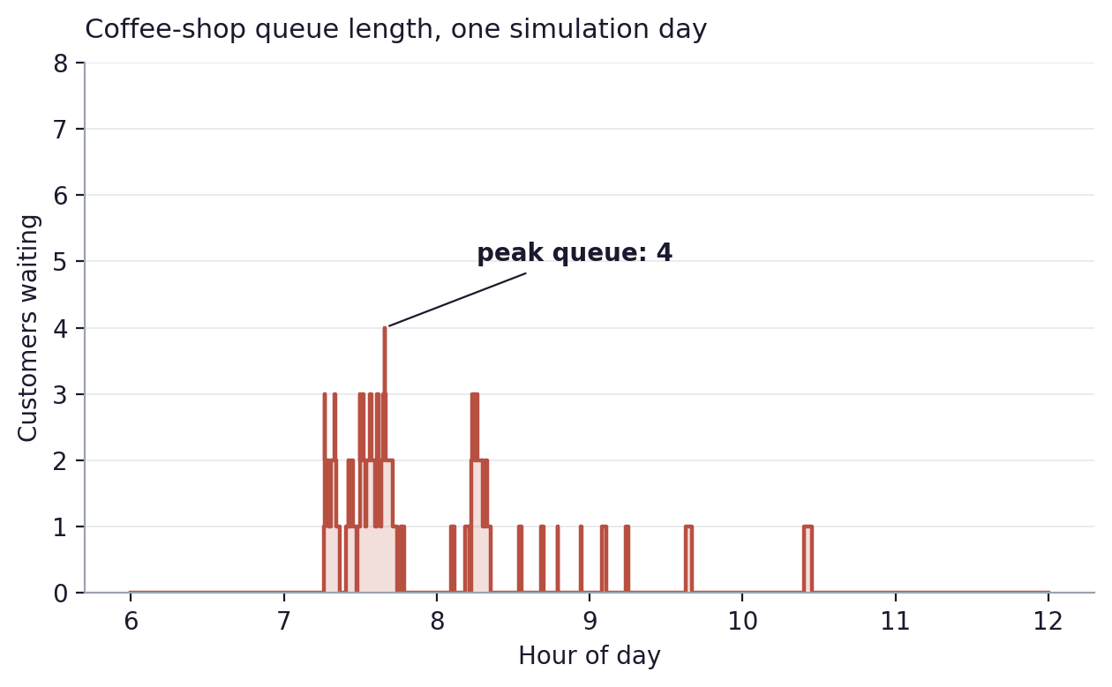
Discrete event simulation
Where bottlenecks come from
Track entities through processes that consume resources
Resources have finite capacity — entities queue when busy
Inter-event times are random (Poisson arrivals, lognormal service)
Time advances event by event, not in fixed ticks
Answers: where are the waits, and how bad do they get?
Two-barista queue, 6 a.m.–12 p.m. The 7–9 a.m. rush is where waits live.
Today's tutorial: a coffee shop with two baristas and a morning rush.

Slide 9
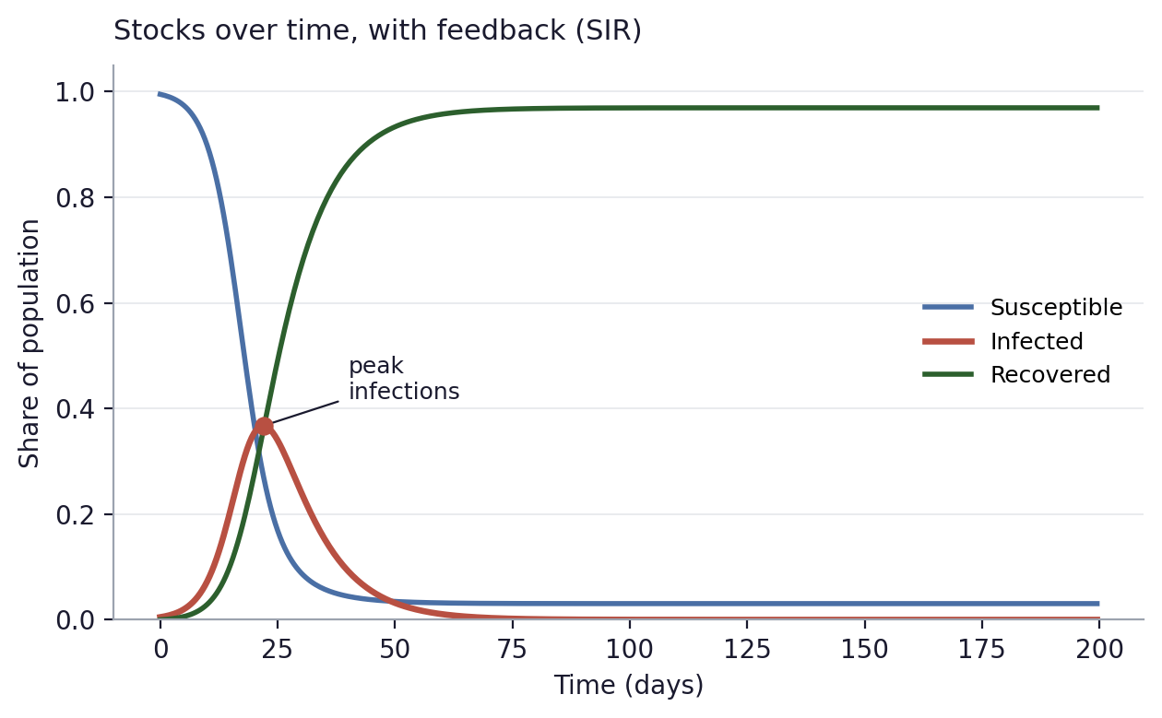
System dynamics
Feedback over months and years
Continuous stocks (levels) connected by flows (rates)
Feedback loops — outputs change inputs at the next time step
Solved with differential equations, not events
Time horizon is months to years, not minutes
Answers: how does a policy change ripple through the system?
SIR model: Infected stock peaks, then drains as Susceptible empties — classic feedback.
Use cases: market share, public health, supply chains, climate models.

Slide 10
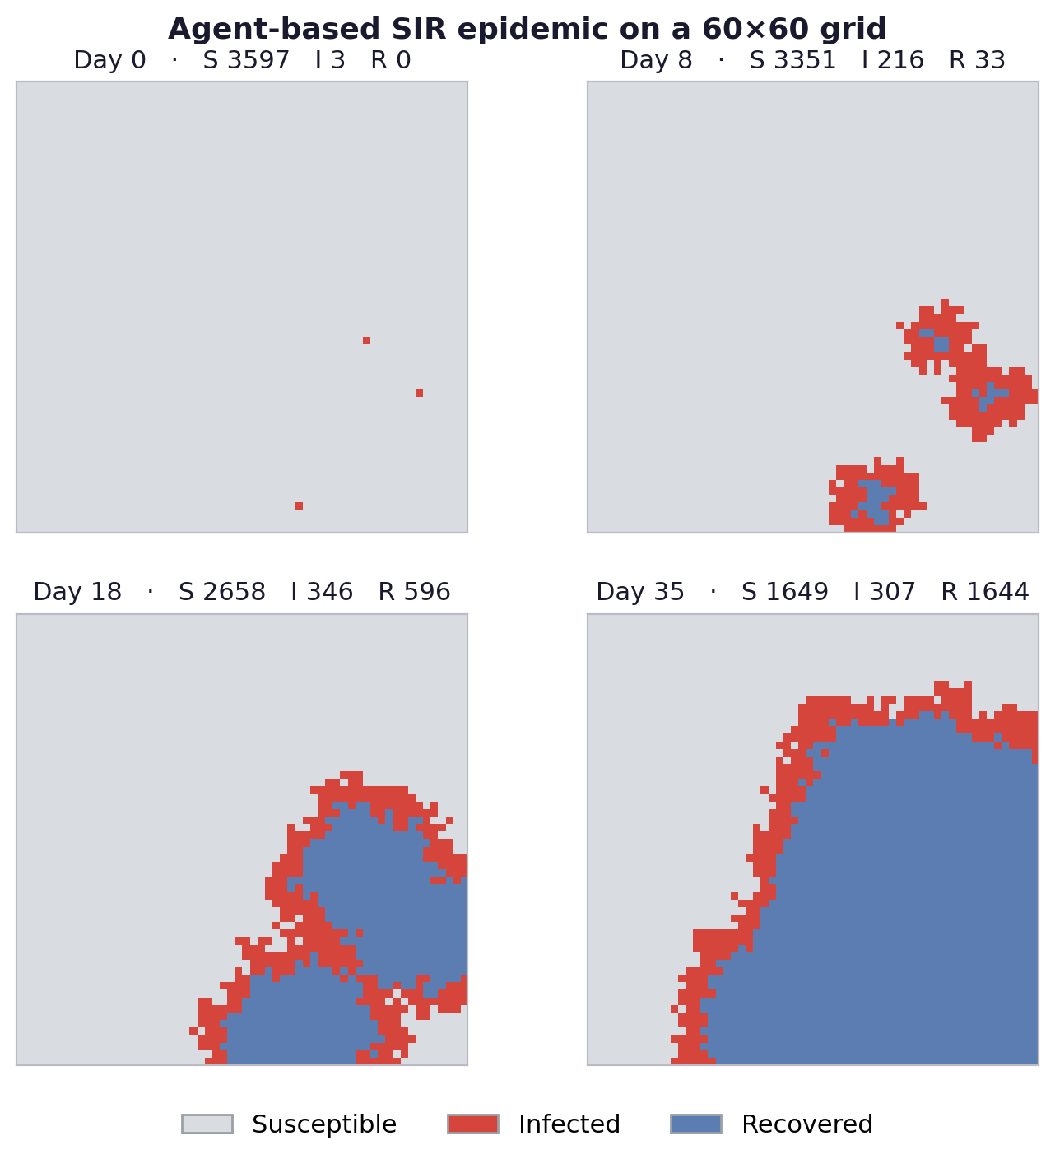
Agent-based modeling
Bottom-up emergent behavior
Many agents, each following simple individual rules
Local interactions on a grid or network
Heterogeneous — different parameters per agent
Global patterns emerge from the bottom up
Answers: what collective patterns arise from individual behavior?
Use cases: opinion dynamics, lane formation, epidemic spread, market crashes.

Slide 11
When to reach for DES
✓
Entities have identities that matter (customers, orders, patients)
✓
Resources have finite capacity that entities compete for
✓
Variability in arrivals or service times drives behavior
✓
The question is about waits, queues, throughput, or bottlenecks
✓
When things happen matters as much as what happens
Notes:
Five signals that you want DES rather than another simulation type. Run through them; the coffee shop hits all five.

Slide 12
Exercise 1 — Classify the scenarios
In pairs, tag each problem: MC · DES · SD · ABM
1.
What's our probability of hitting Q4 revenue target?
2.
Why are patients waiting 45 min when staffing looks adequate?
3.
How does a 10% price increase affect market share over 3 years?
4.
Will pedestrians naturally form lanes on a crowded sidewalk?
5.
Which warehouse layout minimizes order fulfillment during peak?
Notes:
Five scenarios. Pairs work for 5 minutes. Goal is pattern recognition, not deep classification. Include at least one ambiguous case to spark discussion.

Slide 13
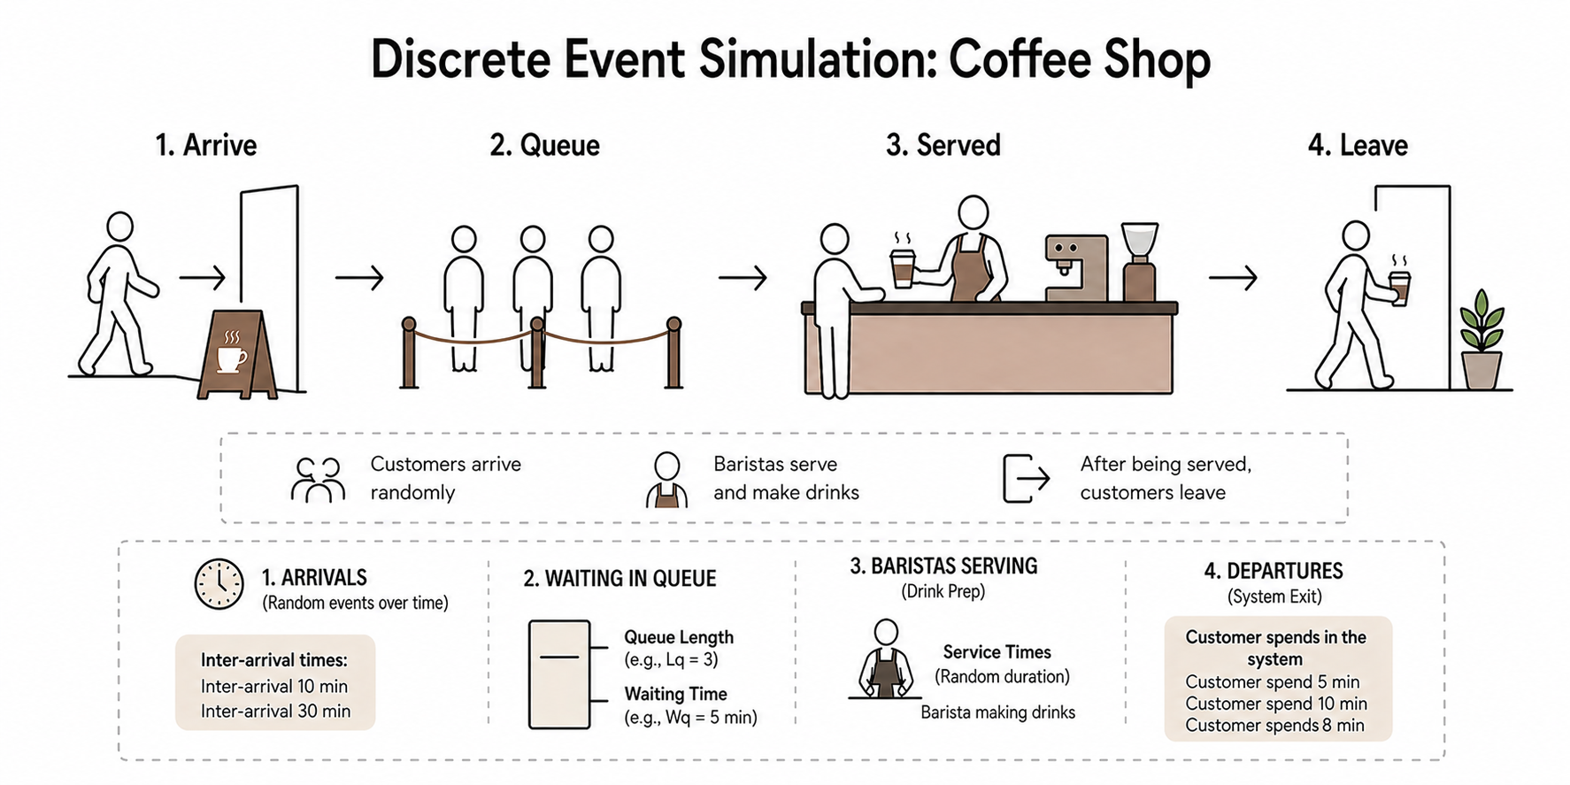

Slide 14
The coffee shop paradox
83%
The setup
2 baristas serving ~18 customers/hour each 30 customers/hour during the morning rush Capacity 36/hr, demand 30/hr — math says fine What the owner sees
morning utilization
Lines of 6+ during the rush.
Customers walking out.
The averages say nothing is wrong.
"Plenty of capacity"
Notes:
The motivating problem. The math says the shop has plenty of capacity. The reality is full lines and walkaways. This is the question the workshop answers: why does this happen, and what should the owner do?

Slide 15
Variability causes backlogs
Wait time does not scale linearly with utilization.
It explodes as you approach 100%.
ρ = 0.50
ρ = 0.80
ρ = 0.83
Short, predictable waits.
Visible queues. Manageable.
Knee of the curve. Long waits during clusters.
Notes:
Show the non-linearity directly. Three utilization levels, three different feels. The shop at 0.83 is right at the knee.

Slide 16
What Averages Miss about Queues
Arrivals cluster
Utilization is non-linear
Random arrivals at 30/hr don't mean 1 every 2 minutes. They mean three customers in one minute and then a five-minute gap. That clustering creates wait spikes that the average rate hides.
Wait time grows much faster than utilization. Going from 50% to 83% busy doesn't make waits 1.6× worse — it makes them dramatically worse. Above 80% the curve is in the knee.
Bottom line: a system can be fine on average and broken in practice.
Notes:
Two reasons together. Random arrivals cluster, and the utilization-to-wait curve is non-linear. An 83% busy system feels nothing like a 50% busy system, even though both have spare capacity on paper.

Slide 17
Before any code, random variables
How do they arrive?
How long does service take?
Random arrivals at a known rate per hour are exponential between consecutive customers. The mean gap is 60 / rate-per-hour. Six months of POS data tells us the rate by hour of day.
Service times are positive and right-skewed. Most drinks take a typical time; a few take much longer. Lognormal is the standard fit. Different drink types get different parameters.
Notes:
These two questions structure all of Block 2. Arrivals: exponential. Service: lognormal. Both fit from data with SciPy.

Slide 18
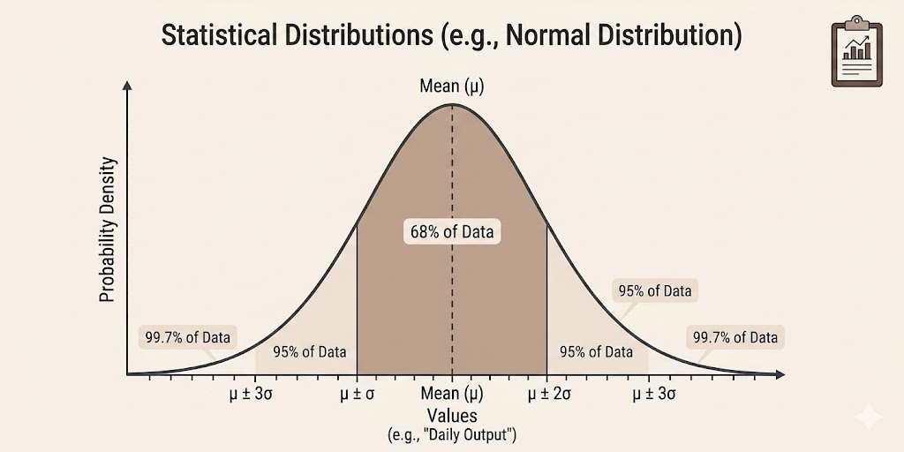

Slide 19
Block 2 · 20 min
Five distribution families
Normal
Symmetric around a mean.
Lognormal
Positive, right-skewed. Service times, transaction values.
Exponential
Inter-arrival times in random arrival processes.
Triangular
Best/likely/worst expert estimates. When data is thin.
Poisson
Counts of independent events. Arrivals per hour, defects per batch.
Notes:
Five families that cover most business modeling work. We'll use exponential and lognormal today; the others appear in your own simulations regularly.

Slide 20
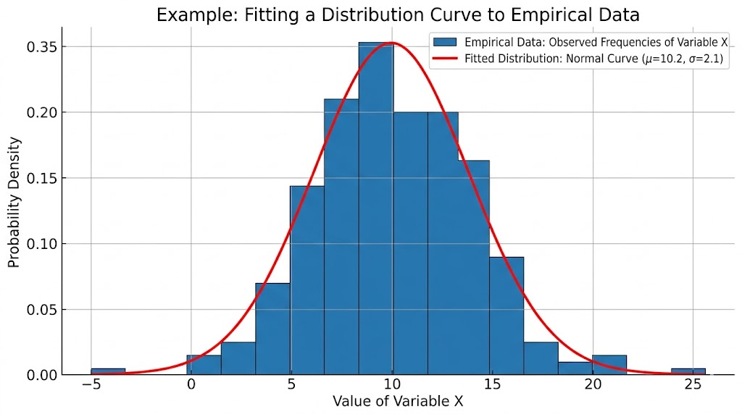
Fitting a Curve
Fit empirical data to a parametric distribution

Slide 21
Block 2 · 20 min
Fitting distributions with SciPy
1
2
3
4
Pick a candidate
Fit parameters
Visualize fit
Sanity check
From domain knowledge, not from the data alone.
stats.expon.fit(...)
stats.lognorm.fit(..., floc=0)
Histogram with PDF overlay. Q-Q plot for the tails.
KS test as a guardrail.
Notes:
Four-step workflow. Pick from domain knowledge, fit, visualize, sanity check. The last two are where most modelers cut corners.

Slide 22
Exercise 2 — Fit and explore
In the Block 2 notebook:
1
Fit exponential to morning-rush inter-arrivals
Recover the 30/hr rate from data with stats.expon.fit.
2
Fit lognormal to service times per order type
Drip, espresso, blended. Visualize the three fits side by side.
3
Explore: change espresso σ and watch P90
Operationalize the 'long-tail' intuition.
4
Compute the M/M/c utilization sanity check
Reproduce the 0.83 number from the data.
Notes:
12 minutes. Solo. Pre-baked plotting helpers, fitting code is one line. The point is intuition, not theory.

Slide 23
Spec-driven simulation development
Simulation code is deceptively easy to write and easy to get wrong.
A misspecified distribution rarely produces an error.
It produces a plausible-looking wrong answer.
Forces clarity
Reviewable by domain experts
Becomes the LLM prompt
About modeling decisions before coding begins.
Without making them read code.
A precise spec is a precise prompt.
Notes:
Three reasons spec-driven dev matters in simulation specifically. The third is the one this workshop hinges on: the spec becomes the prompt.

Slide 24
Block 3 · 20 min
Three templates, one workflow
A
B
C
→
→
Process & Resource Spec
Code Generation Prompt
Validation & Results
Entities, resources, queue rules, distributions, scenarios, pre-checks.
Wraps Template A. Prescribes the 5-function SimPy architecture.
Spec compliance, internal consistency, reasonableness, communication readiness.
The same A → B → C loop applies to Monte Carlo, system dynamics, and ABM.
Notes:
Three templates. The flow is A → B → C, but iteration goes both ways: validation findings update the spec.

Slide 25
Block 3 · 20 min
Template A — what's inside the spec
Entities
Resources
Customers with order type, patience threshold.
Baristas. Capacity that varies by shift.
Distributions
Queue behavior
Exponential arrivals, lognormal service per order type.
FIFO. Balking at queue ≥ 8 at arrival.
Scenarios
Pre-checks
Baseline, A: rush boost, B: all-day three, C: process change.
M/M/c utilization. Cost calculation. Sanity numbers.
Notes:
Six sections of Template A for the coffee shop. The spec is reviewable by the shop owner without reading code, and it's the input to the code-generation prompt.

Slide 26
Exercise 3 — Review the completed Template A
Review the completed Template A and verify each specification:
1.
Balk rate is set — confirm the queue-length threshold that triggers a walkaway
2.
Espresso distribution parameters are set — confirm the lognormal μ and σ for espresso
3.
Staffing schedule is defined — confirm baristas per time window across the day
4.
Labor rate per hour is set — confirm the hourly wage used in cost calculations
Verifying a completed spec is the same skill as filling one in.
If a value is missing or ambiguous, the simulation can't run reliably.
Notes:
12 minutes. Strategic blanks force participants to think through the modeling decisions, not copy numbers. Debrief in 2 minutes.

Slide 27
Block 4 · 25 min
Template B — turning the spec into code
A code-generation prompt prescribes architecture and intent.
entity_process(...)
Customer lifecycle: arrive → balk-or-queue → serve → depart
entity_generator(...)
Time-varying Poisson arrivals
run_single_replication(...)
One simulated day with given seed
run_scenario(...)
N replications under one staffing plan
compare_scenarios(...)
Aggregate, compare, report
Prescribed architecture is what makes the generated code reviewable.
Notes:
Template B wraps Template A. The five-function architecture is what makes the LLM-generated code consistently reviewable. Without it, every prompt produces a different code shape.

Slide 28
Block 4 · 25 min
Six places the LLM earns its keep
Code generation is the most visible. The other five matter just as much.
LIVE
LIVE
1. Generate code
2. Review logic
3. Verify spec compliance
From spec via Template B prompt.
LLM walks each function; compare to your mental model.
Find deviations between spec and code.
4. Validate vs reality
5. Generate test scenarios
6. Document assumptions
Check whether output is plausible given domain knowledge.
Adversarial what-ifs that stress the structure.
Stakeholder-facing appendix and findings.
Today: drill into 2 (live). The other 4 are pre-built notebook cells you run after the workshop.
Notes:
This is the slide you asked for. Six LLM uses across the modeling lifecycle. We drill into two live (code generation here in Block 4, spec compliance in Block 5). The other four ship as bonus notebook cells with pre-written prompts so participants can use them on their own simulations after the workshop.

Slide 29
SimPy
Python · Discrete-event simulation
A process-based discrete-event simulation framework for Python.
Processes: Active entities (customers, patients, packets) modeled as Python generators that yield events.
Resources: Limited resources with capacity (servers, beds, machines) — processes request and release them.
Queueing: Built-in support for queues, preemption, priorities, and stores for inventory.
Pythonic: Lightweight, pure Python — install with pip, runs anywhere, integrates with NumPy and pandas for analysis.
Open: Free and open-source (MIT license); active community and well-documented examples.

Slide 30
Block 4 · 25 min
Demo — Spec to SimPy
DEMO
Pre-captured LLM chat.
Template A + Template B → SimPy code → run → matches.
The point: a precise spec is a precise prompt.
Better spec → better code, every time.
Notes:
Pre-recorded screencast plays here. Two minutes. Live LLM demos in workshops are unpredictable — the screencast preserves the point without the risk.

Slide 31
Exercise 4 — Run the baseline
Run the baseline scenario at 50 replications. Read three signals:
Mean wait ≈ 2 min
Sounds fine. Hides the actual problem.
P90 wait ≈ 6.4 min
The customer behind the complicated order. This is what people feel.
Walkaway rate ≈ 0.9%
Lower than the owner expected. Not the main pain point.
Discussion: where is the actual customer-experience problem?
Notes:
15 minutes. Run baseline, look at three signals, discuss. The answer is P90 wait — most customers stay but have a bad experience. That insight reframes the decision.

Slide 32
Block 5 · 15 min
Validation — Template C
A simulation that runs is not the same as a simulation that's right.
Verify spec compliance
Internal consistency
Does the code do what the spec says? LLM-assisted.
Warm-up handling, replication counts, no negative durations.
Reasonableness
Communication readiness
Sim utilization vs analytical M/M/c. Match the owner's experience.
Probability statements and ranges, not standard deviations.
Notes:
Four validation concerns. Spec compliance is the one we drill into with LLM assistance. The others are mostly mechanical and live in the notebook.

Slide 33
Block 5 · 15 min
The invisible-bug class
Same simulation. Two implementations. Spot the difference.
Metric
Spec-compliant
Buggy
Mean wait (min)
1.99
1.89
P90 wait (min)
6.55
5.98
Walkaway rate
0.9%
1.3%
Max queue length
8
8
Both look plausible. The bug is real and important.
It's invisible in the metrics — and very visible in the spec.
Notes:
This is the central pedagogical point of Block 5. Two implementations, near-identical metrics, but one violates the spec. This is the bug class spec-driven validation with LLM review exists to catch.

Slide 34
Block 5 · 15 min
LLM-assisted spec compliance review
Curate
Constrain
Triage
→
→
Template A + the code + the summary results.
Structured JSON output. Severity. Category. Evidence.
Real bug. Valid observation. False positive. You decide.
The LLM finds candidates. You decide what's a bug.
Notes:
Three-step flow. The LLM doesn't decide what's a bug — you do. The triage step is what makes this exercise honest about the LLM's limitations.

Slide 35
Block 5 · 10 min hands-on
Exercise 5 — Triage the LLM's findings
Block 5 notebook. The cell ships with a saved fallback so it works offline.
1
Run the spec-compliance review cell
2
Read each flagged issue: evidence, why-it-matters, fix
3
For each: real bug · valid observation · false positive
4
Compare your triage with your neighbor's
The seeded code contains two real defects. The LLM flags them and a few false positives.
Your job is the triage call.
Notes:
10 minutes. Two seeded defects (balking misplaced; missing positivity check). LLM also raises some non-bug observations. The point is feeling what triage is like.

Slide 36
Block 6 · 15 min
Four scenarios, four levers
Baseline · $289/day
A: Rush boost · $323/day
2 / 2 / 1 baristas. The reference. Today's setup.
+1 barista 7-9 AM only. +$34/day. Targeted fix.
B: All-day three · $459/day
C: Process improvement · $289/day
+1 barista in every window. +$170/day. Excessive.
15% faster service in rush, no extra labor.
The interesting comparison: A versus C. One adds labor, one changes the workflow.
Notes:
Four scenarios. Baseline + A + B + C. The pedagogically interesting comparison is A versus C — does the workflow change get you most of the benefit at zero labor cost?

Slide 37
Block 6 · 15 min hands-on
Exercise 6 — Compare and recommend
Run scenarios A, B, C alongside the baseline. Read four signals:
P90 wait — the experience customers actually feel
Walkaway rate — lost revenue and word of mouth
Morning utilization — analytical sanity check (target ~0.83 → 0.56)
Daily labor cost — what the owner actually pays
Then write a 2-3 sentence recommendation to the owner.
No jargon. Connect to the decision.
Notes:
15 minutes total. Run scenarios, compare metrics, write the recommendation. The constraint forces synthesis. We'll read a few aloud at the end.

Slide 38
Block 7 · 5 min
The spec-driven loop, in one sentence
Data → distributions → spec → code → results → validation → decision.
The LLM is in the loop at every stage.
Generating, reviewing, validating, summarizing, documenting.
Never running unsupervised.
Notes:
One-sentence recap. The LLM is in the loop everywhere but never running unsupervised. That distinction is the entire workshop.

Slide 39
Block 7 · 5 min
Two takeaways
1. The expensive bugs in simulation don't crash. They look right.
Misspecified distributions, missing dependencies, wrong order of operations. None produce errors. All produce plausible wrong answers. Spec-driven dev plus LLM-assisted spec review is the cheapest way I've found to catch them before they ship.
2. The same A → B → C loop applies beyond DES.
Monte Carlo, system dynamics, agent-based — same templates, different content. The biopharma manufacturing case study in Chapter 5 swaps customers for batches and baristas for safety cabinets. The structure carries.
Notes:
Two things to leave with. The bug class point is the most important takeaway. The transferability point is the reason this isn't just a coffee shop workshop.

Slide 40
Block 7 · 5 min
Resources
The book
Simulation Models for Data Science (forthcoming, O'Reilly). Chapter 5 is the source for today's example. Chapter 4 covers Monte Carlo with the same A/B/C templates.
The repo
Notebook, SimPy code, the three DES templates, the synthetic POS dataset, and the bonus LLM cells for the four uses we didn't drill into live today.
Contact
dan@sullivanlearninggroup.com. Happy to talk through your simulation problems.
Notes:
Pointers to keep going after the workshop. The bonus notebook is the highest-leverage thing for participants who want to apply this to their own work.

Slide 41

Questions?
Dan Sullivan · dan@sullivanlearninggroup.com
http://bit.ly/4vTVdU0
Notes:
Wrap. Open Q&A as time permits.

